Slide 1
BELLWORK
On a piece of paper, write down at least two joints you can think of that perform these movements.
If you don’t know what one is, ask a classmate before you ask me!
Flexion
Extension
Adduction
Abduction
Rotation

Slide 2
Terminology
Anatomical Movement
Lesson Three
August 28, 2017

Slide 3
Terminology-Introduction
Take out your list of medical terms and definitions.
As we define the terms, if the term is on your list cross it off of you list.

Slide 4
Terminology-Anatomical Movement
Flexion
To bend or decrease the angle of a joint
Wrist
Elbow

Slide 5
Terminology-Anatomical Movement
Extension
To straighten, increase the angle of a joint
*Restore to anatomical position
Hip
Ankle

Slide 6
Terminology-Anatomical Movement
Abduction
Away from the mid-line
Fingers
Shoulders

Slide 7
Terminology-Anatomical Movement
Adduction
Toward the mid-line

Slide 8
Terminology-Anatomical Movement
Rotation
Movement around a central axis
Internal = Towards the middle
External= Away from the middle

Slide 9
Terminology-Anatomical Movement
Circumduction
Movement in a circular pattern that outlines a cone
A combination of many movements

Slide 10
Terminology-Anatomical Movement
Supination
Rotation of the forearm so that the palm is turned superiorly or anteriorly
How would you hold a bowl of soup?

Slide 11
Terminology-Anatomical Movement
Pronation
Rotation of the forearm so that the palm is turned posteriorly or inferiorly

Slide 12
Terminology-Anatomical Movement
Inversion
Ankle moves so that the plantar surface of the foot is turned inward

Slide 13
Terminology-Anatomical Movement
Eversion
Ankle moves so that the plantar surface of the foot is turned outward

Slide 14
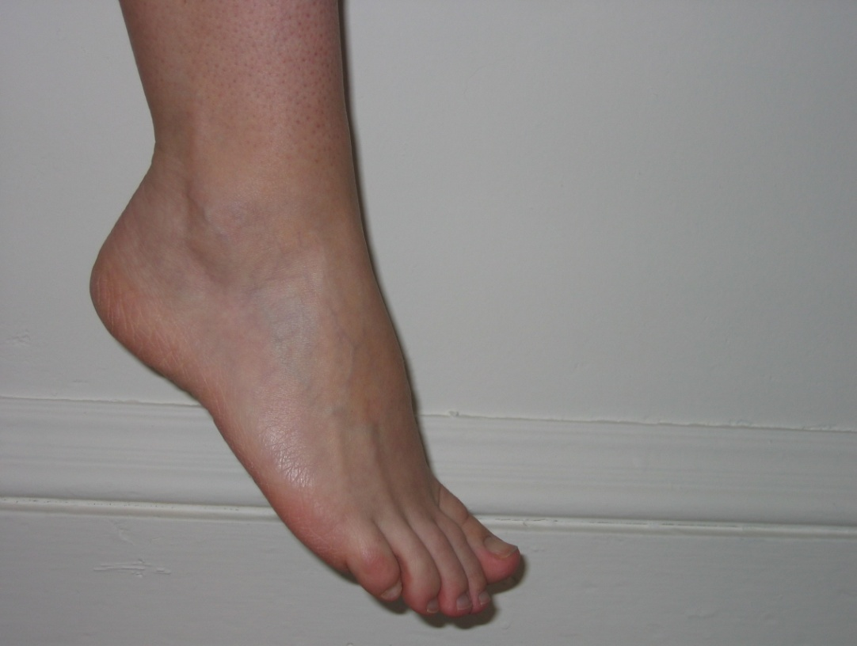
Terminology-Anatomical Movement
Plantar Flexion
Ankle moves so that the plantar surface of the foot is pointed downward

Slide 15
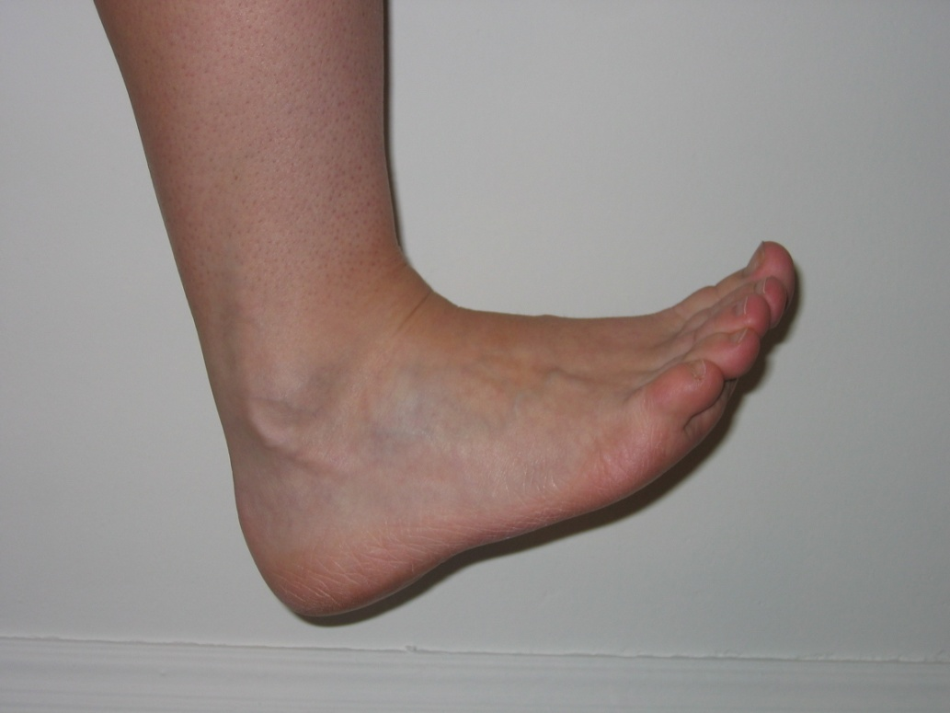
Terminology-Anatomical Movement
Dorsiflexion
Ankle moves so that the dorsal surface of the foot is moved upward

Slide 16
Terminology-Anatomical Movement
Elevation
Raising a body part
Shrug shoulders

Slide 17
Terminology-Anatomical Movement
Depression
Downward movement of a body part

Slide 18
Terminology-Anatomical Movement
Protraction
Movement of a body part forward
Round shoulders –scapula protracts
Push jaw out – mandible protracts

Slide 19
Terminology-Anatomical Movement
Retraction
Movement of a body part backward

Slide 20
Opposites that are partners!
Extension is the opposite of ___________________.
Depression is the opposite of ___________.
Supination is the opposite of ___________.
Retraction is the opposite of ___________.
Eversion is the opposite of __________________.
Adduction is the opposite of ___________.
Medial Rotation is opposite of ___________.
Circumduction makes a ____________________.

Slide 21
Simon Says!
Everyone stand up…
Let’s practice our anatomical movements!!

